Slide 1
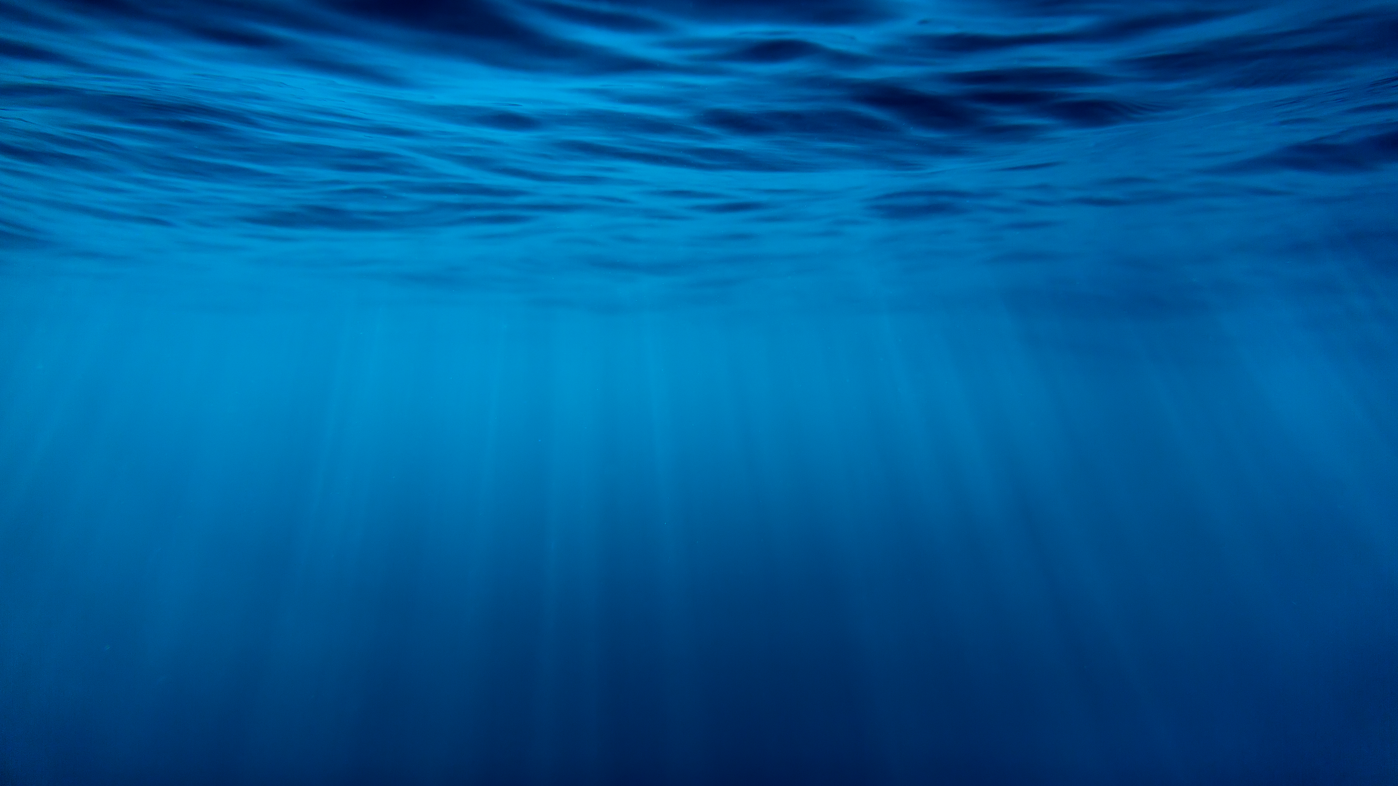
Fish Adaptations

Slide 2
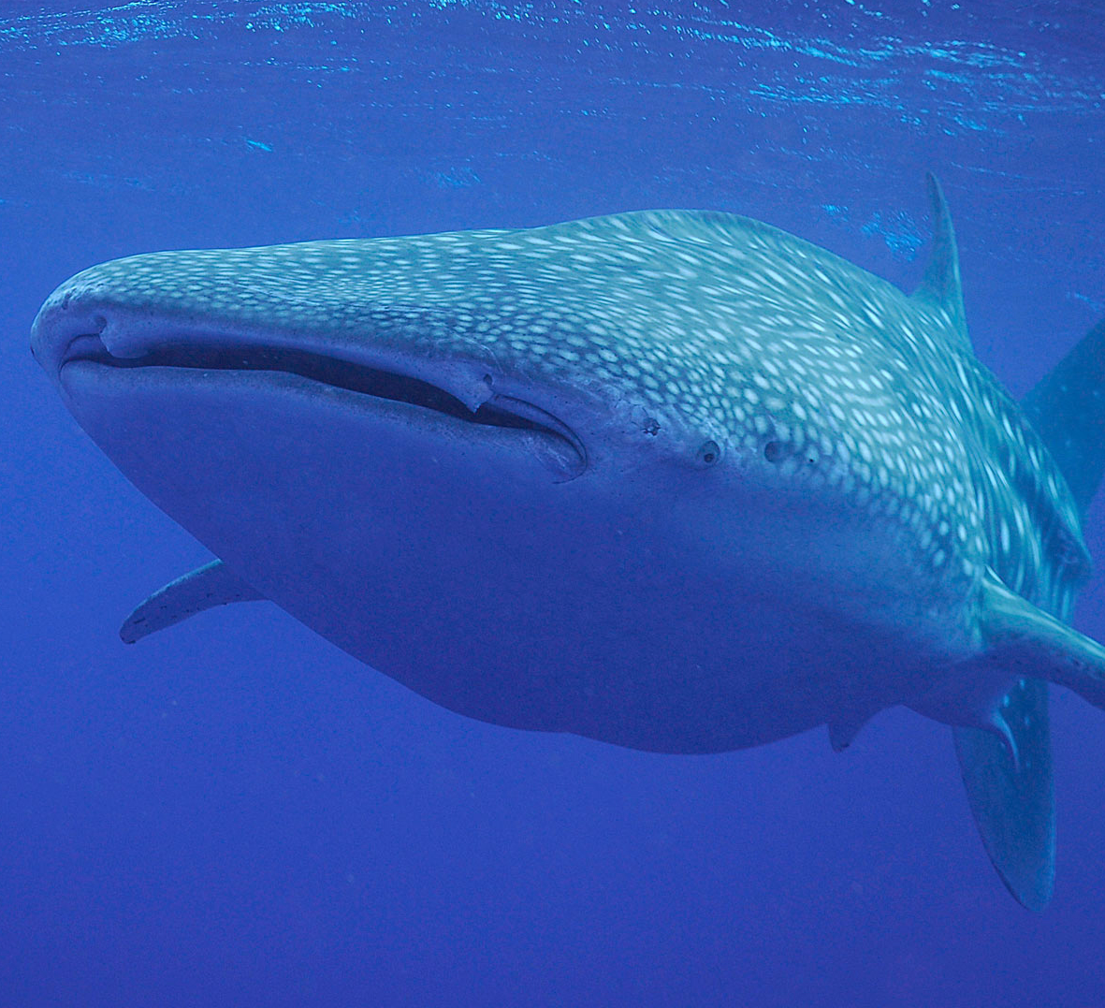
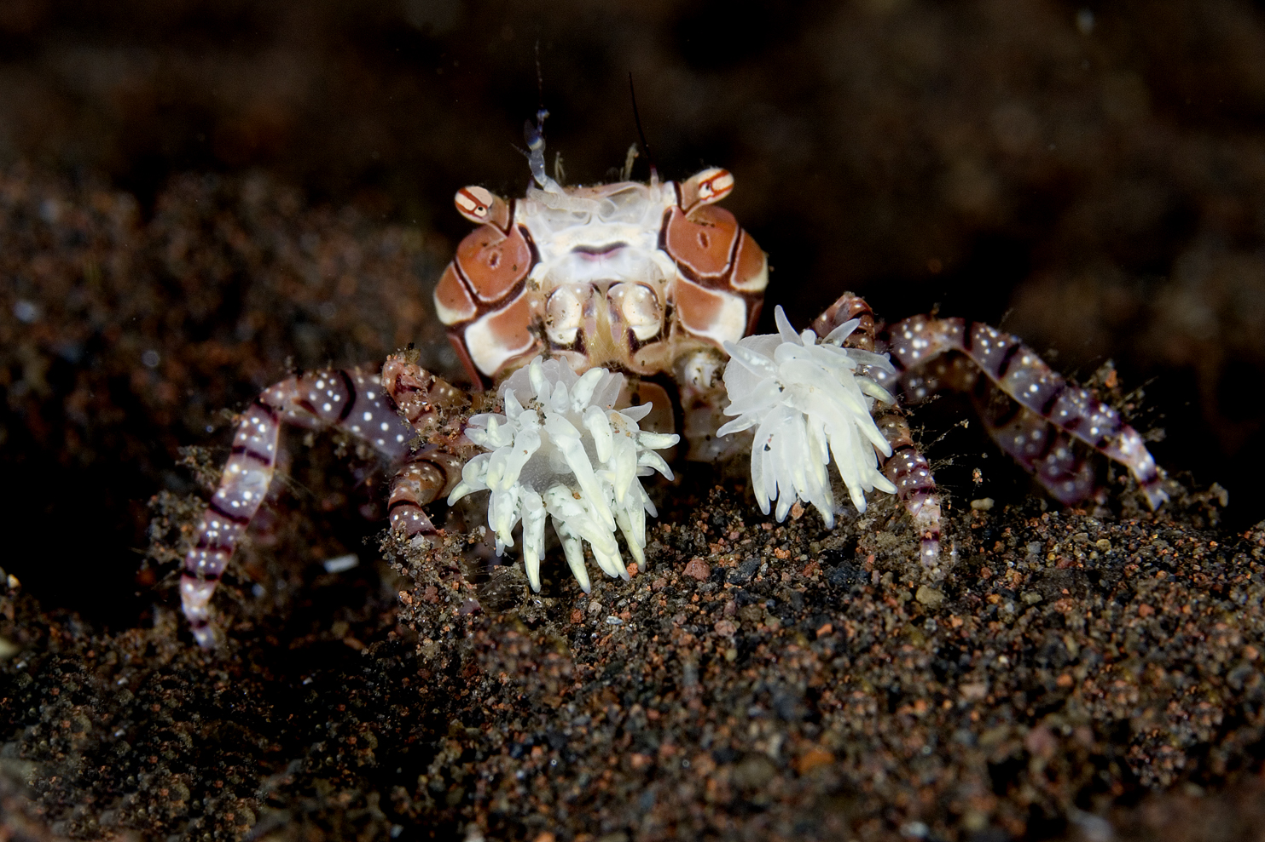
You can tell a lot about the way a fish looks, such as where it lives, how it feeds and how it moves through the water!
Adaptations are features that increase the animals’ likelihood of surviving in their habitat.

Slide 3
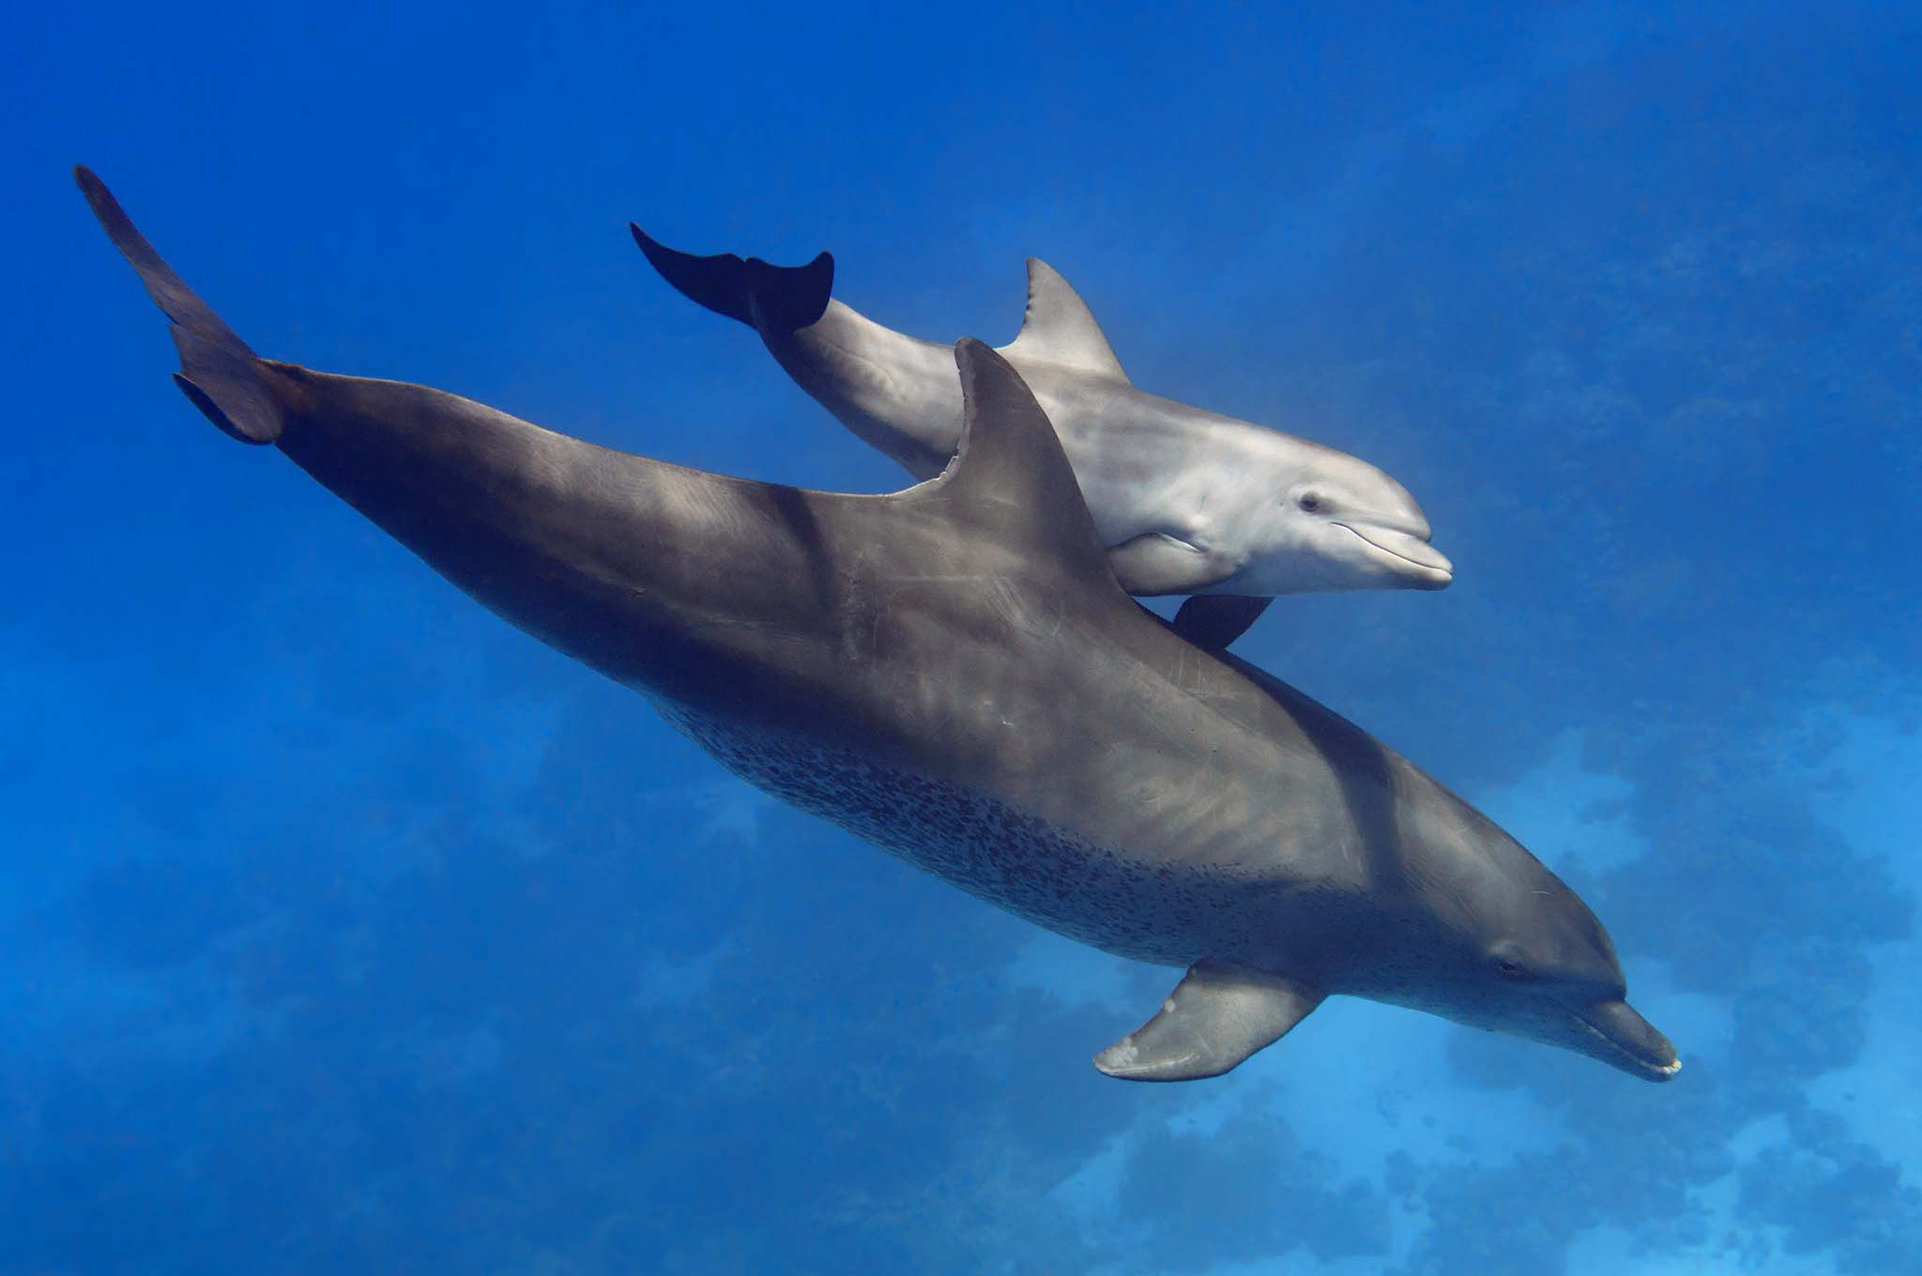

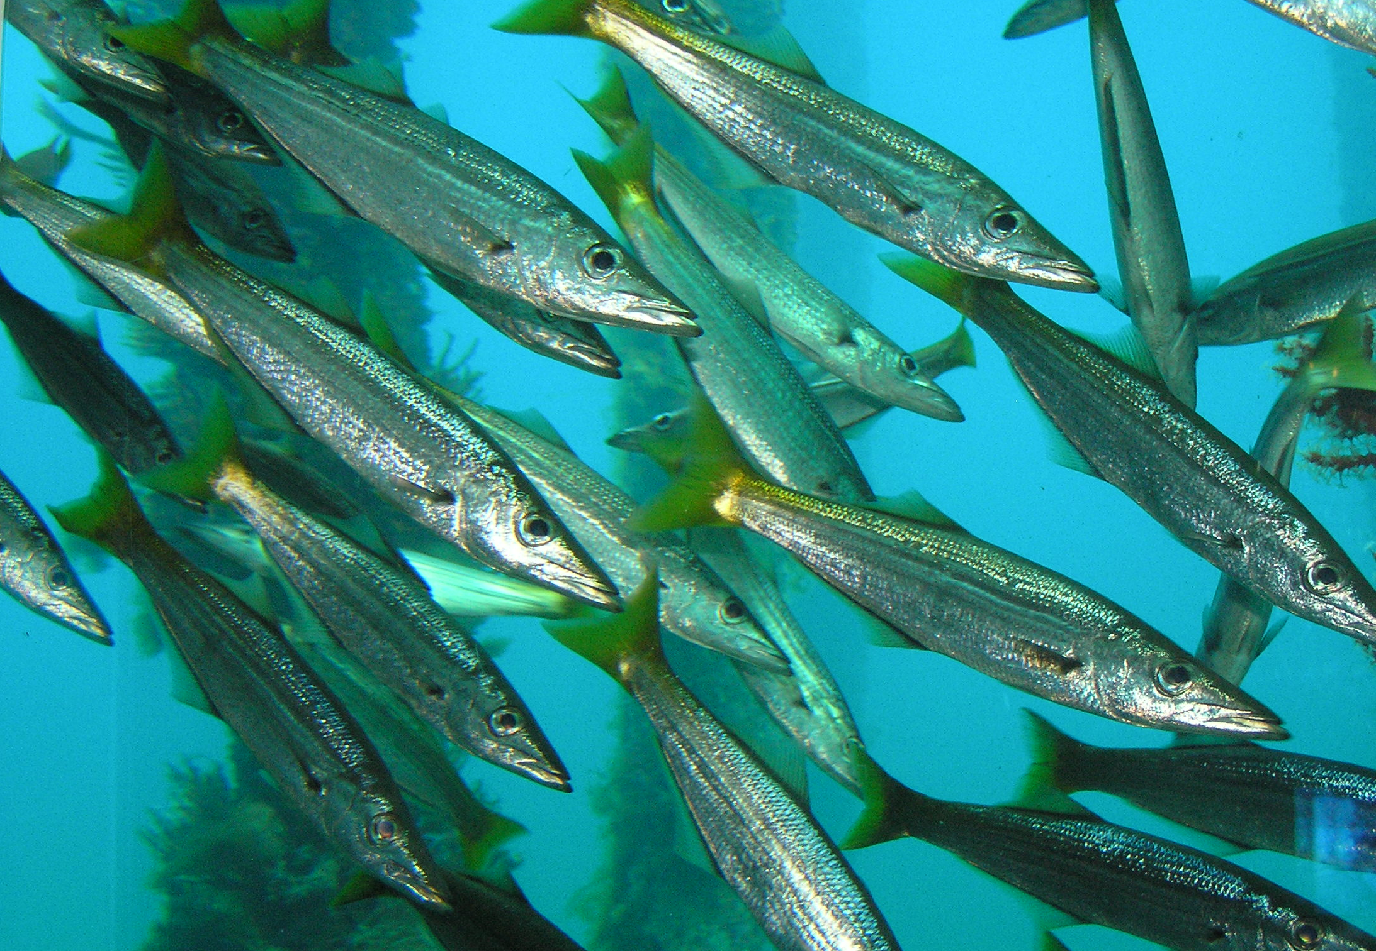
Behavioural Adaptations
A behavioural adaptation is an action that animals carry out to increase their chances of survival and reproduction
e.g. schooling, escaping, care of young, warning signals

Slide 4
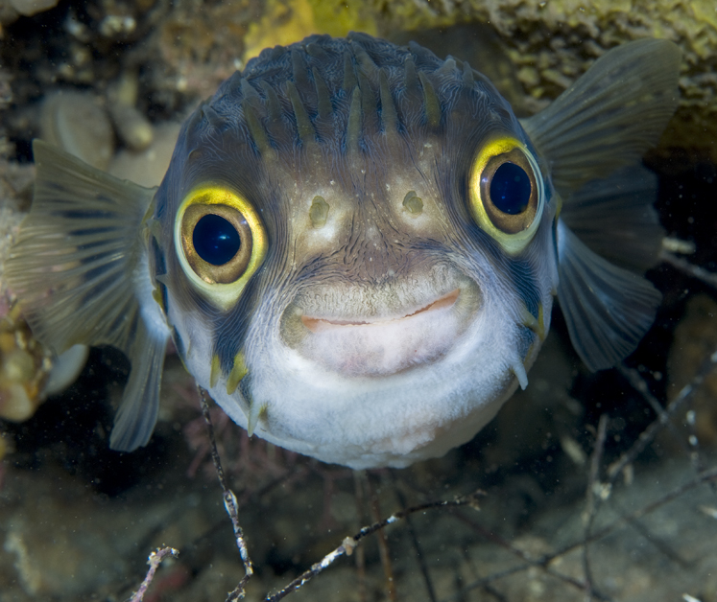
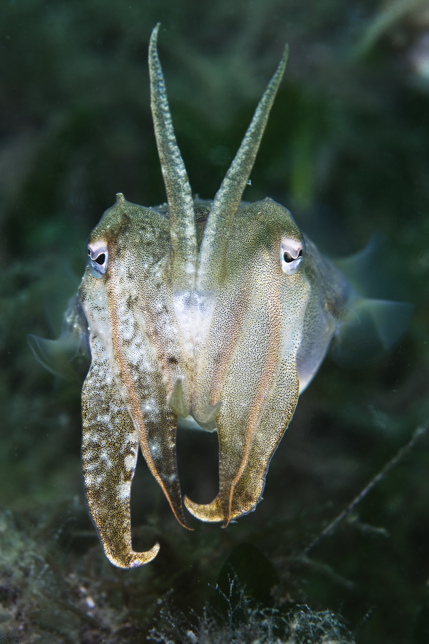
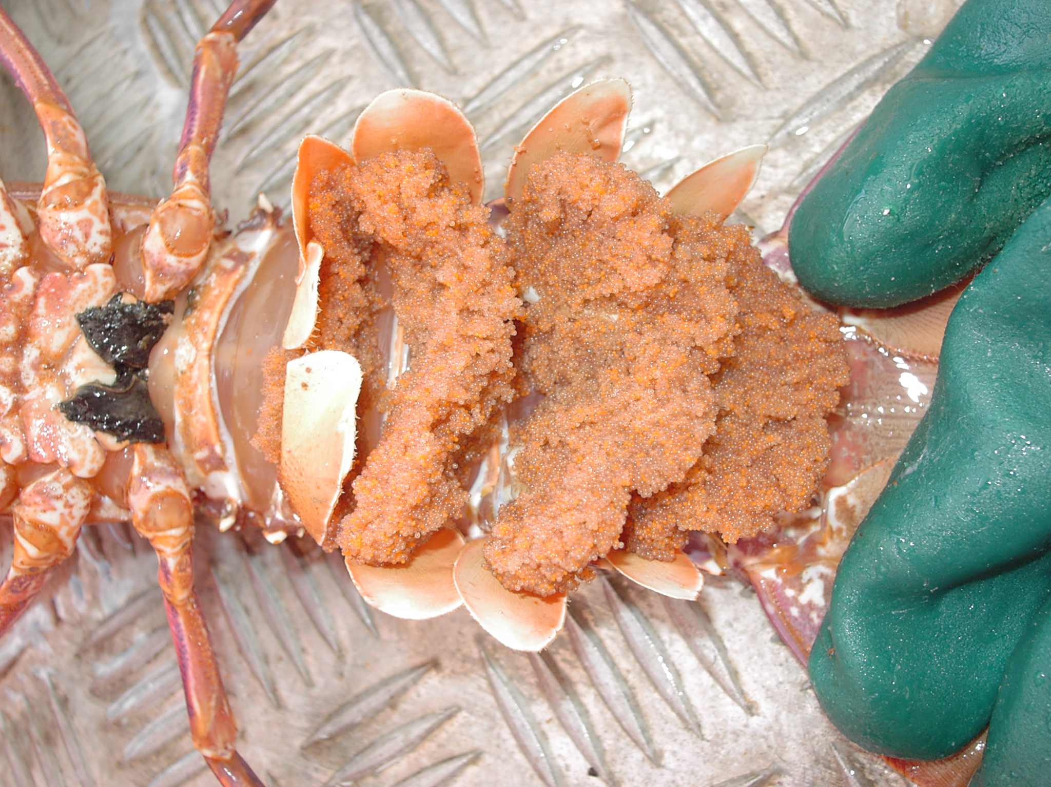
Physiological Adaptations
A physiological adaptation is where internal processes aid in survival and reproductive success
e.g. poisons, reproducing in large numbers to increase chances of survival and colour change.
Notes:
Functional or Physiological (e.g. buoyancy, poisons and colour change)
Cuttlefish utilise chromatophores in their skin to change colour and blend into its environment (chromatophores are a pigment-containing or pigment- producing cell)
Globefish have poisonous spines on their body to protect from predators
Care of young: some species (e.g. crustaceans) have a large number of eggs as they do not care for their young. This increases the chances of them surviving to maturity and beyond.

Slide 5
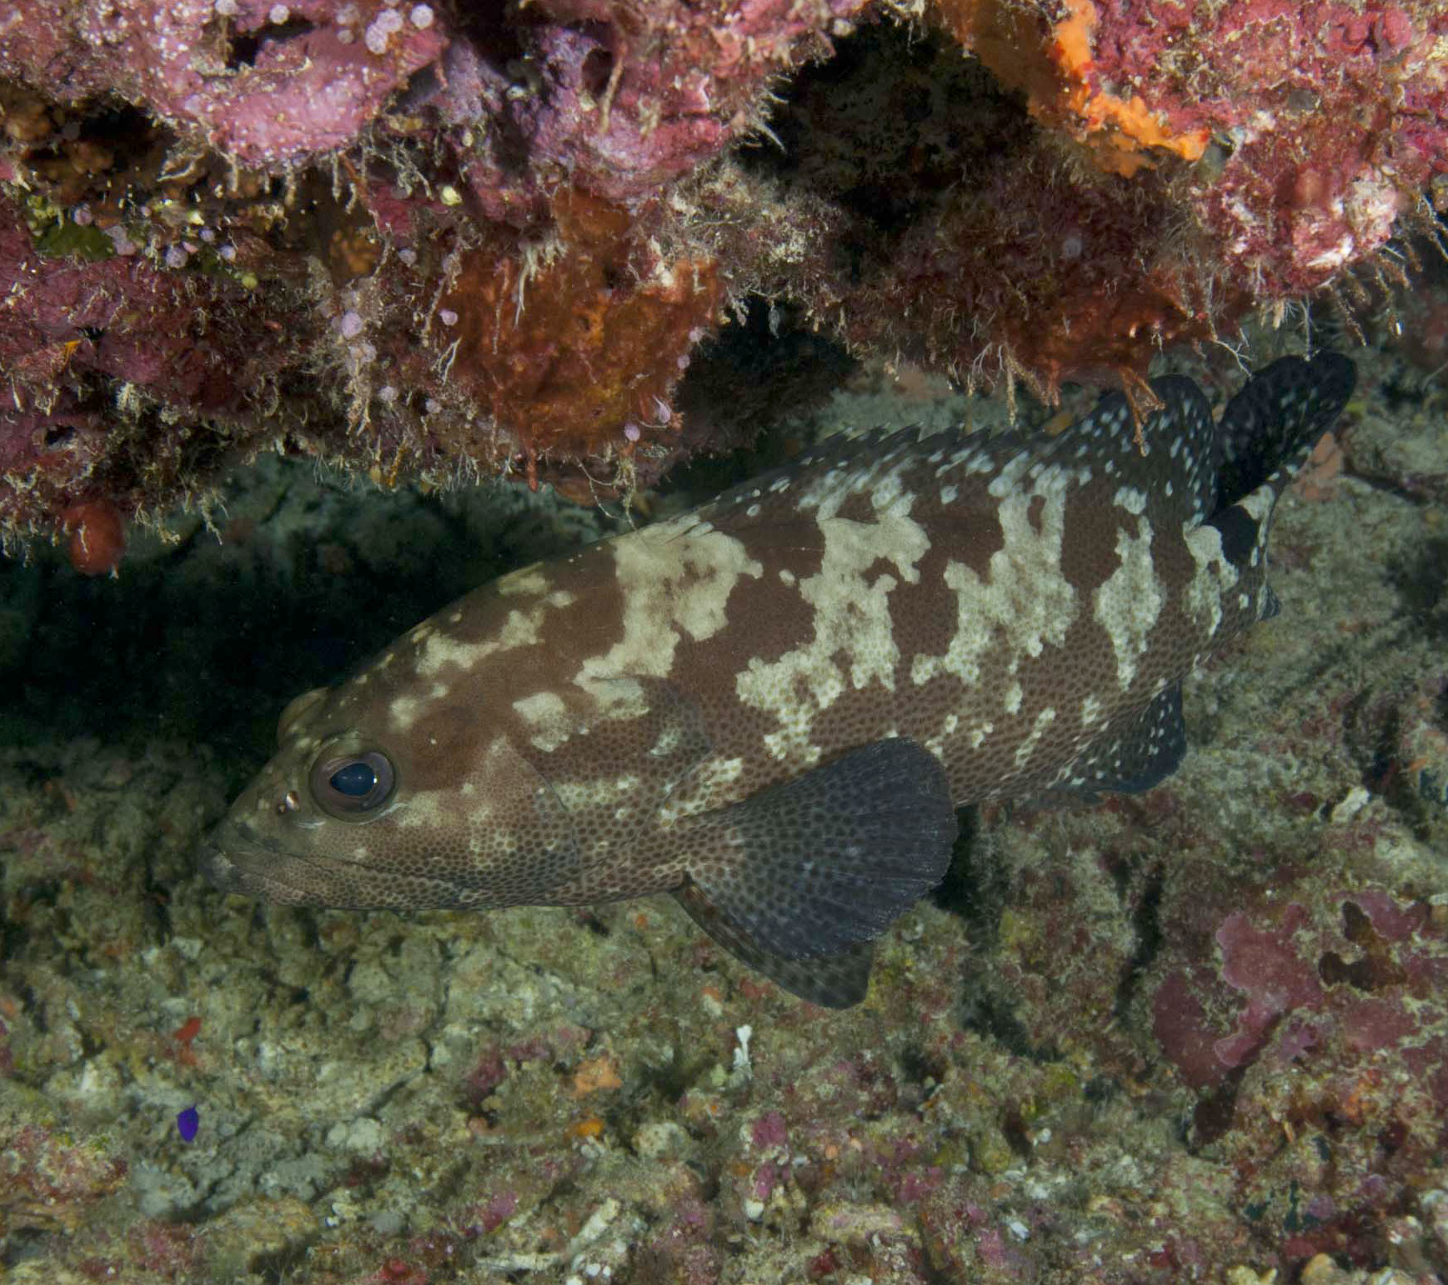
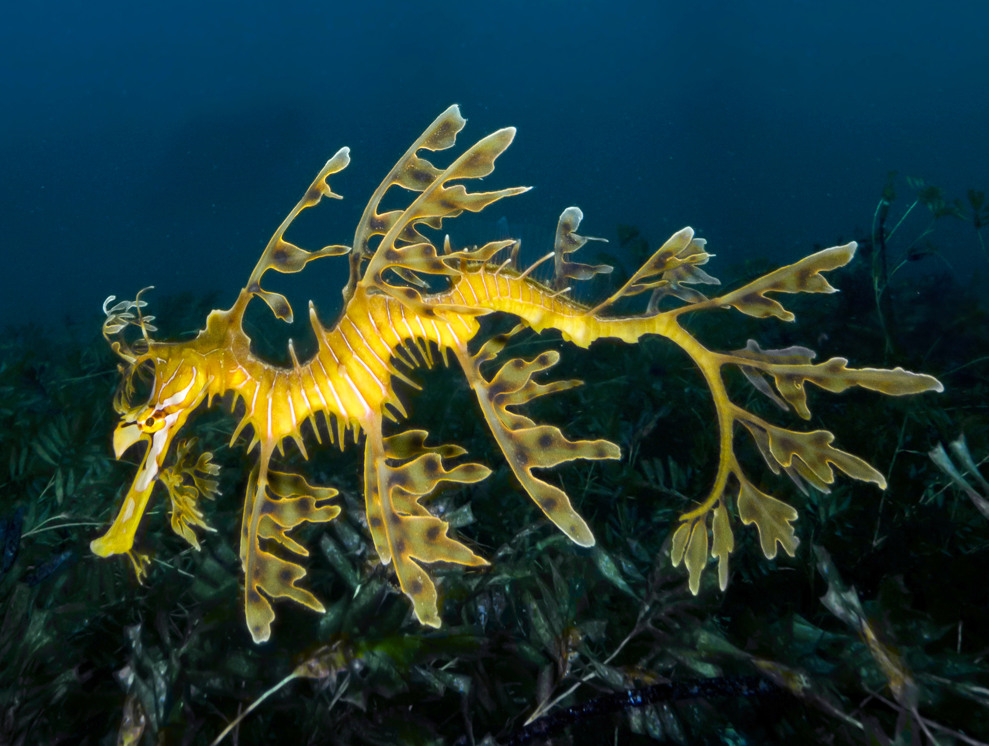
Structural Adaptations
A structural adaptation is a physical characteristic that aids survival and reproductive success
e.g. body shape, body cover, camouflage, appendages and mouth parts.
Notes:
Fish body shapes can be broken up into three distinct groups as seen in the diagram.
Extreme accelerating (mulloway)
Extreme cruising (tuna)
Extreme manoeuvring (bannerfish)
Demersal fish are generally flat in shape as they don’t swim continually therefore have no need to be streamlined
Flat pancake like shape indicates the fish is able to stay close to the seafloor where they feed.
Fish that live in crevices have deep flat bodies but are highly agile (can move around without bumping into rocks and reefs)
Long slender fish (e.g. eels and cobbler) are able to hide under rocks and amongst coral where shorter stouter shaped fish would have difficulty in going
Slow moving fish with rounded bodies e.g. boxfish and globefish, are often protected by spines or armoured plating and have poisonous flesh owing to their lack of maneuverability
Fish with elongated bodies e.g. WA Salmon, are able to swim very fast for a long time thus have no need for any special body protection

Slide 6
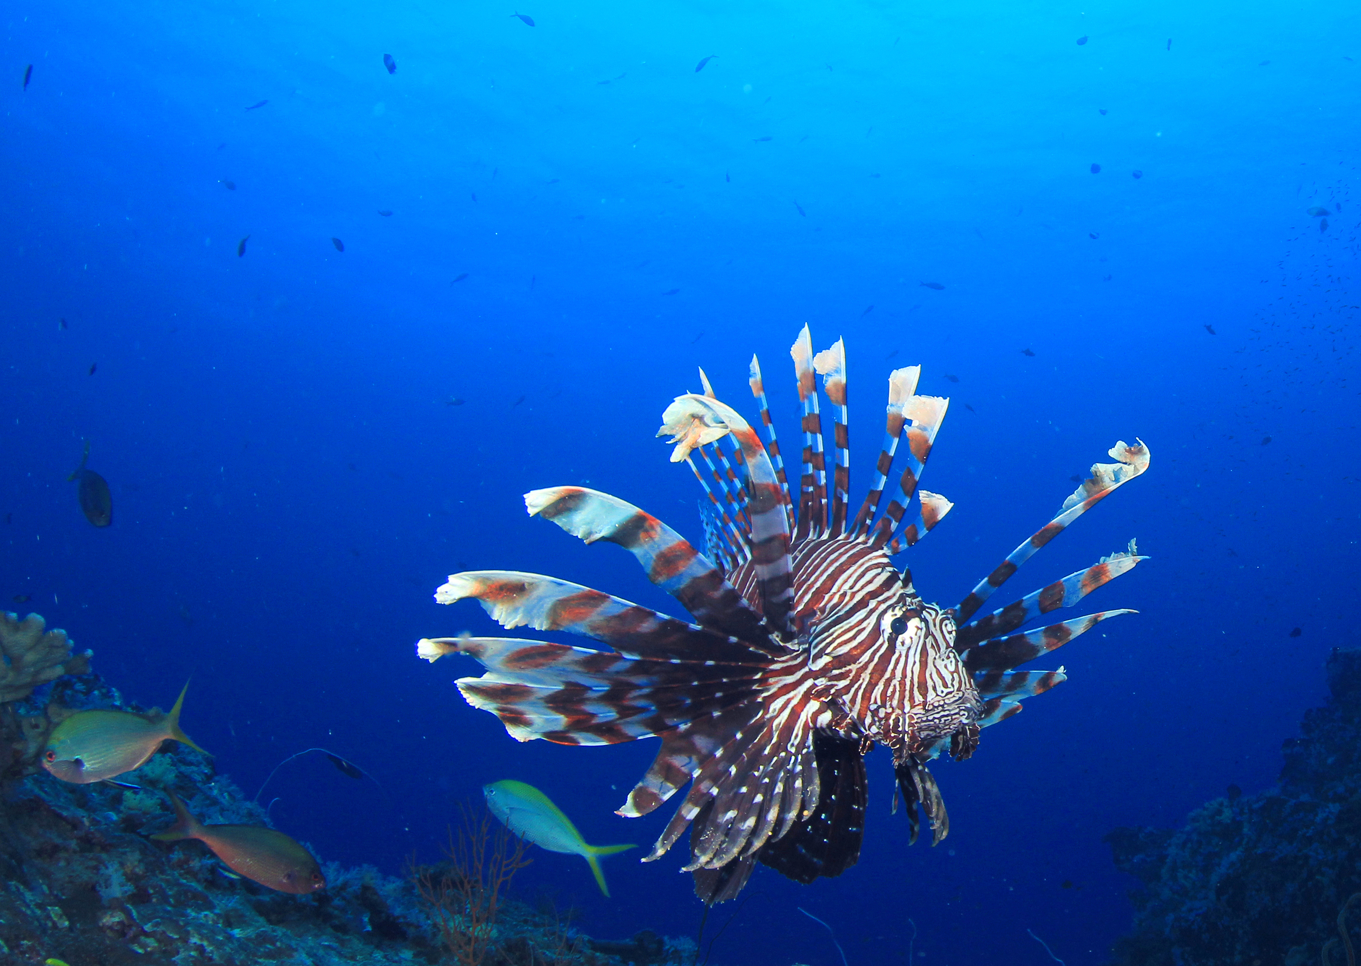
Lionfish have a striking colouration that is a ‘warning’ to potential predators, reinforced with poisonous dorsal fin spines. Lionfish can remain almost motionless and use their
fan-like pectoral fins to herd and
trap prey. They have a large mouth for swallowing prey whole
with a lightening fast gulp.
Lionfish

Slide 7
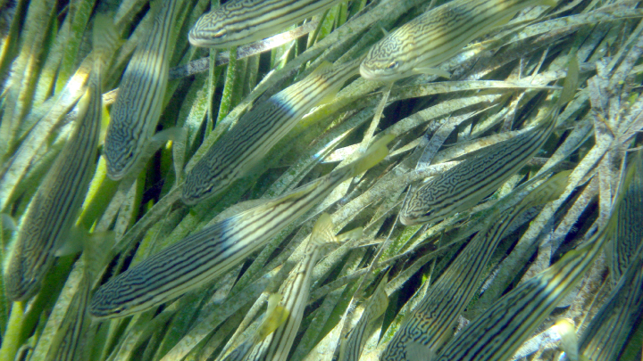
Striped trumpeter
Striped trumpeters have dark markings which help them blend into seagrass meadows, confusing predators from above.

Slide 8
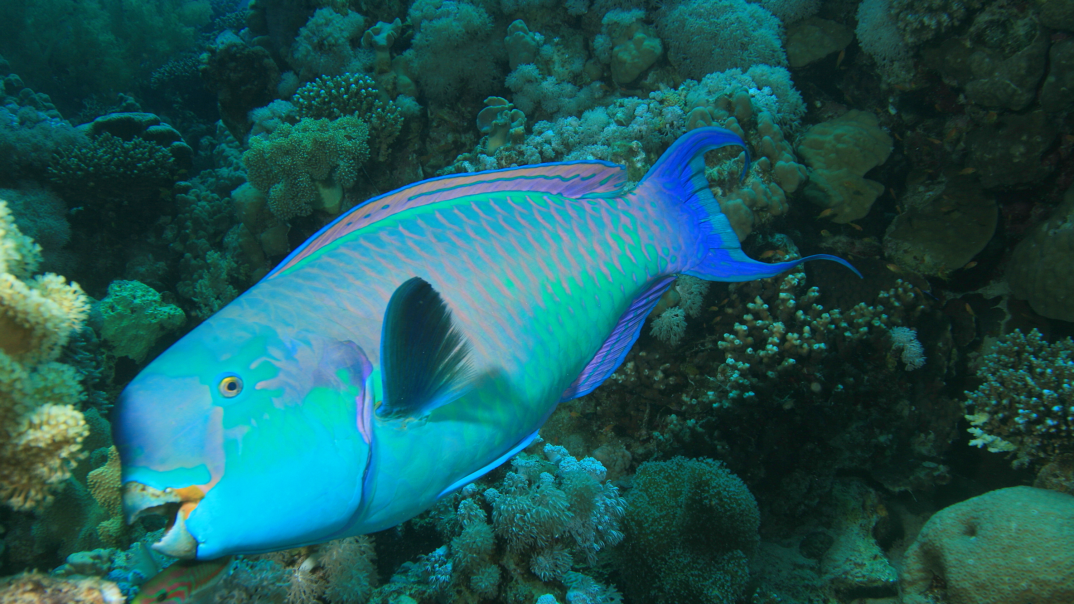
Parrotfish have fused teeth resembling a bird’s beak, used to scrape algae from reefs. Parrotfish mainly use their pectoral fins for locomotion. Its colouration blends into the reef background from a distance, yet at close range it allows them to ‘talk’ to the same species. Some species can excrete a protective mucus cocoon, thought to hide its scent from predators.
Parrotfish

Slide 9
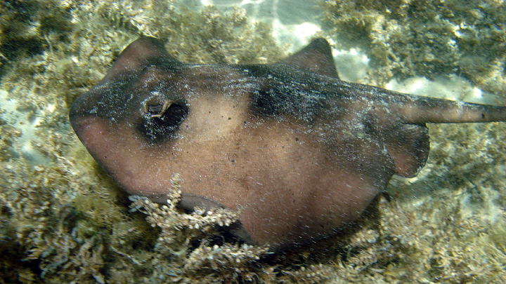
Ray
Rays have a flattened body suited to life close to the sea floor. Their eyes are positioned on top of their head which allow them to see prey when they bury into sand. They have excellent senses and some species have a venomous barbed stinger on the tail.

Slide 10
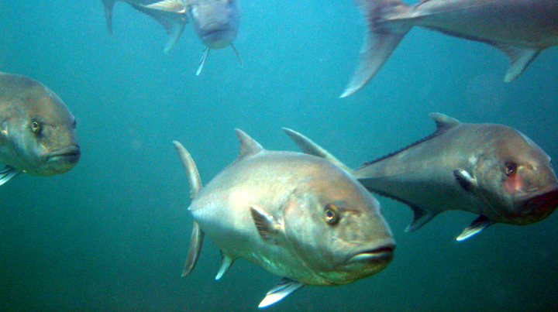
Samson fish are a large predatory fish of the open water. They have a torpedo-shaped body and a powerful forked tail which enables them to swim very fast to catch prey.
Samsonfish
Photo: © Russell Cocker

Slide 11
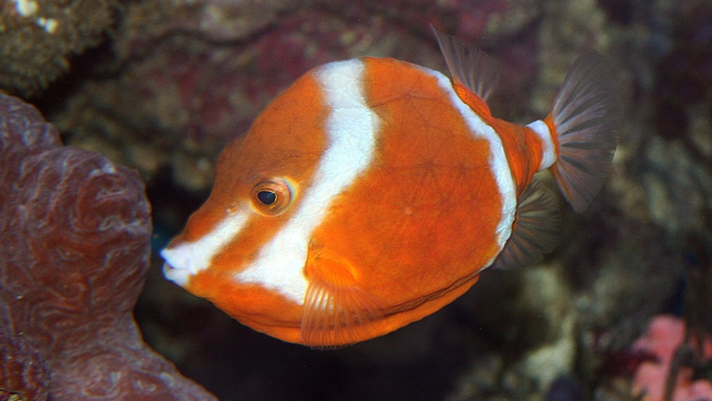
White-barred boxfish have a protective covering of large, thick, joined scale plates which create an armour against predators. As a poor swimmer, boxfish have the additional advantage of being poisonous to eat.
White-barred boxfish

Slide 12
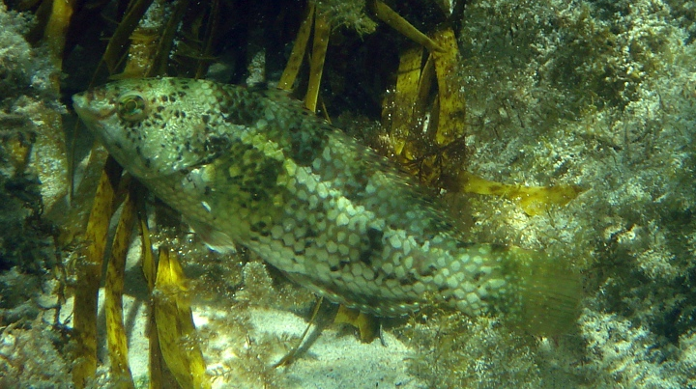
Brown-spotted wrasse have a mottled pattern and mosaic colouration. When threatened the fish will sit on its side and remain very still to camouflage with the sea floor.
Brown-spotted wrasse

Slide 13
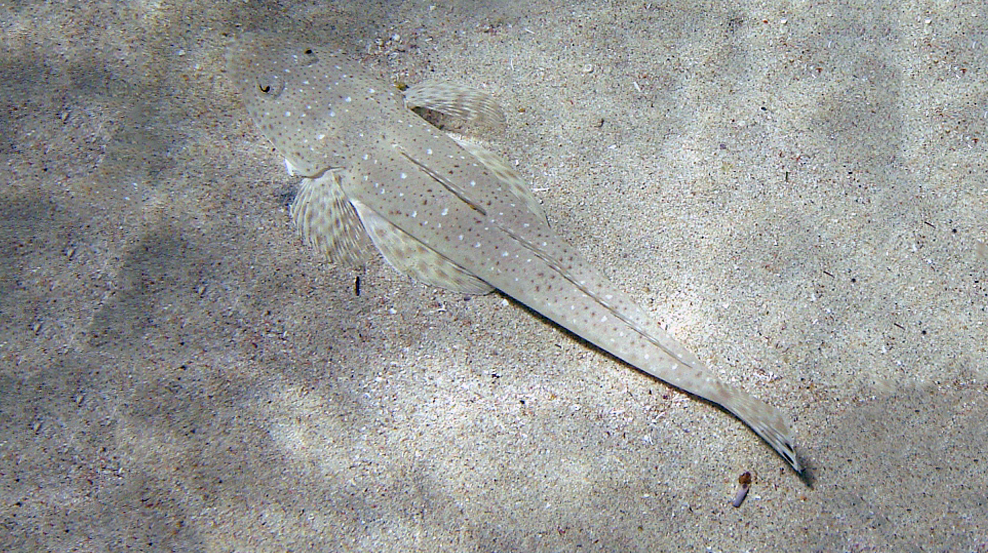
Flathead
Flathead have a flattened body, large mouth and eyes positioned on top of the head. They camouflage very well on a sandy or muddy sea floor. They are a ‘lie and wait’ predator and use their rounded tail for a short burst of speed to catch prey by surprise.

Slide 14
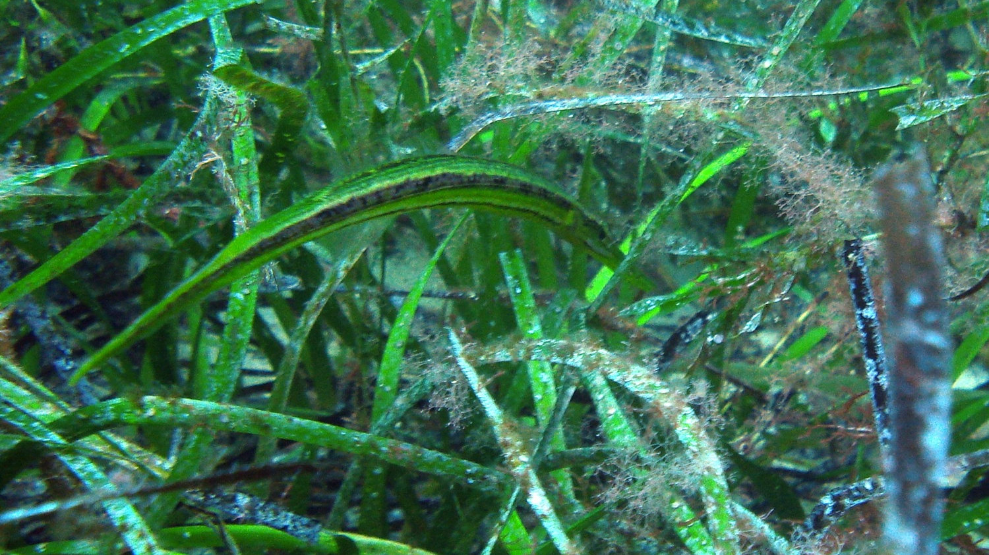
Tubemouth
Tubemouths have a long slender body and tube-like mouth to forage for food, deep into seagrass foliage. Its green colouration and dark markings make them well camouflaged in seagrass meadows.

Slide 15
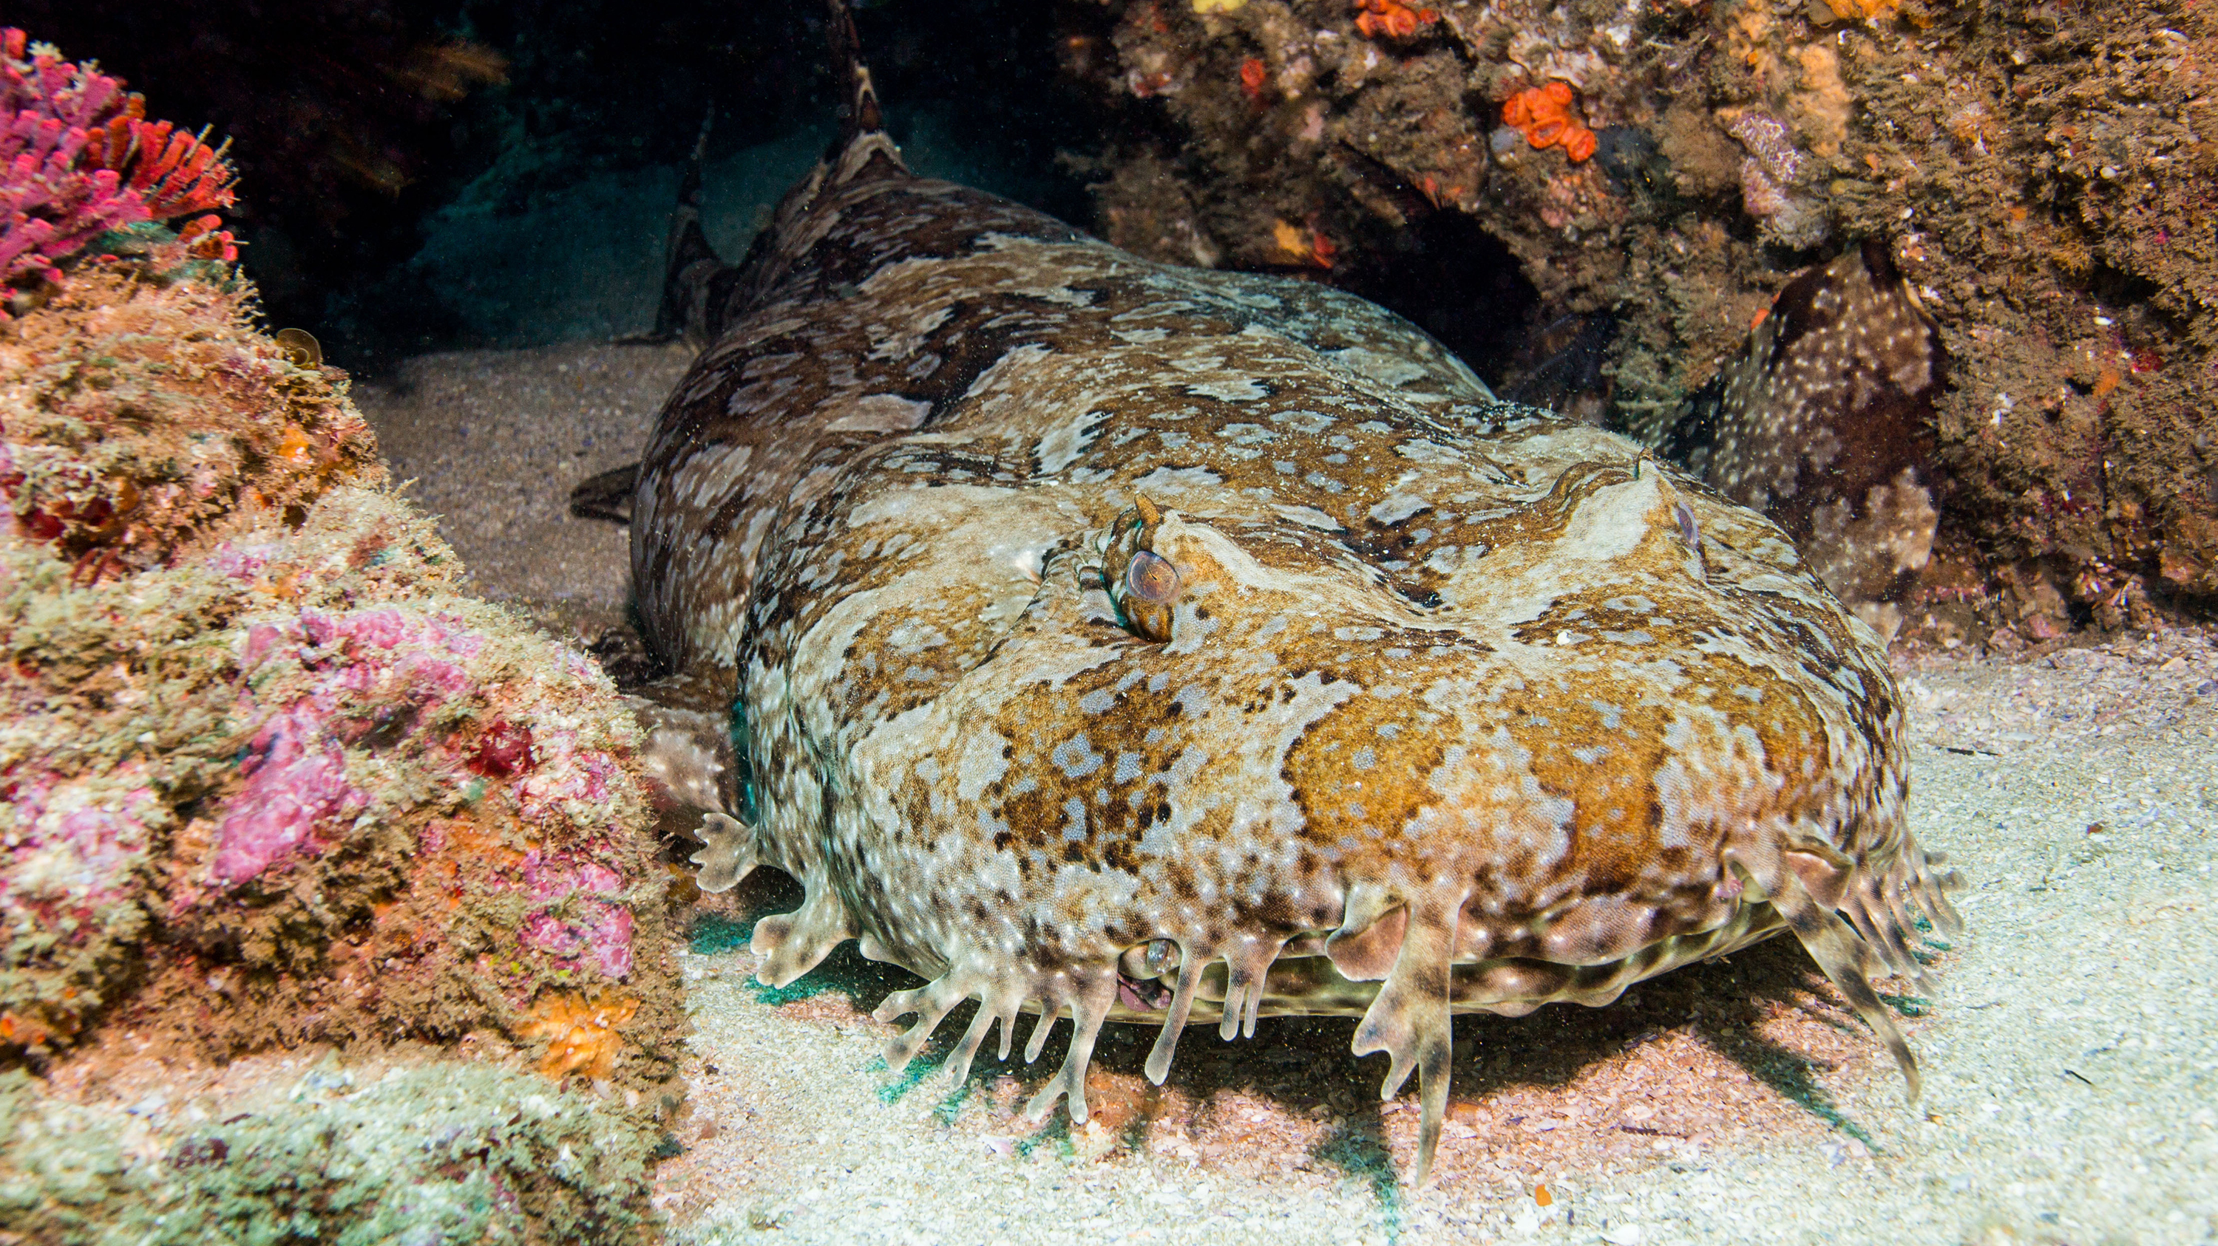
Wobbegong sharks rest on the seafloor and are primarily nocturnal.
O-shaped markings and mottled patterns aid in camouflage. Several tassels around the mouth can attract potential prey whilst needle-like teeth grasp prey.
Wobbegong shark

Slide 16
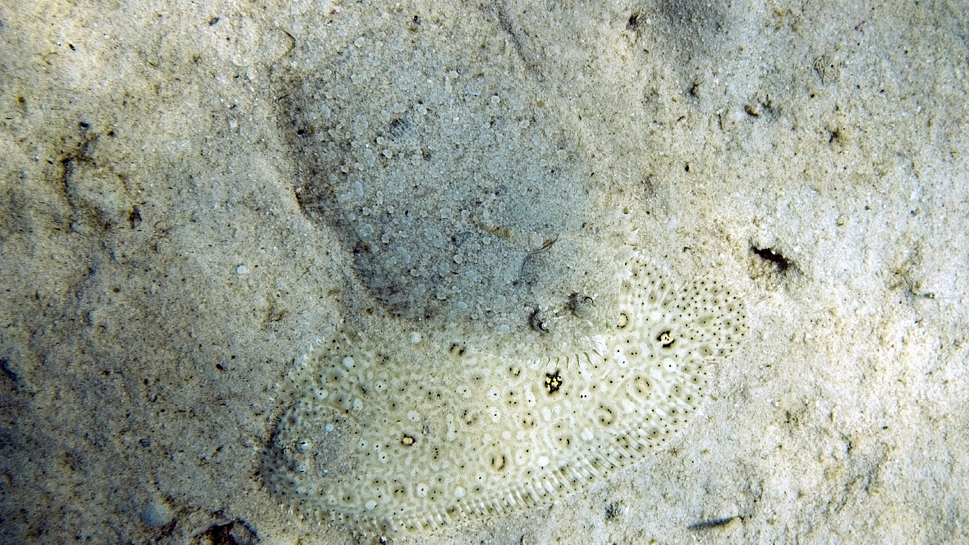
Flounder
Flounder are ideally adapted to life on the sea floor with a flattened pancake-shaped body and two eyes sitting up high on one side of its head. Flounder have exceptional camouflage ability and can rapidly blend into their surroundings. Flounder lie and wait in position for prey to swim past within striking distance. With a lightning quick flick of fins and extension of their jaw,
small fish and crustaceans are captured with a blink
of an eye.
Photo: © Microgen

Slide 17
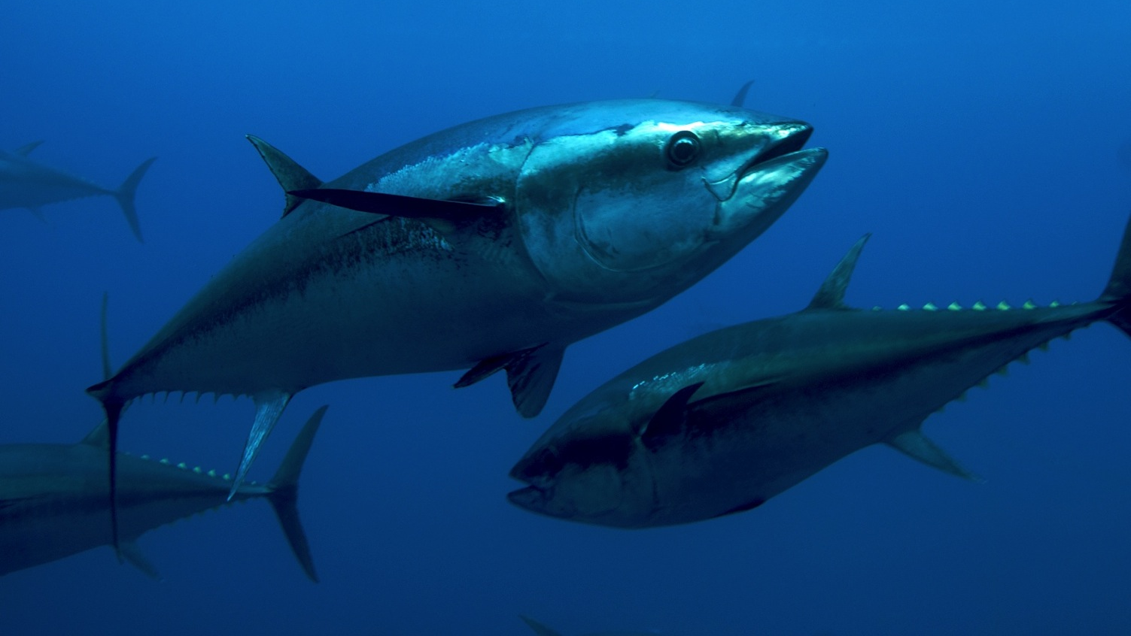
Tuna are extremely streamlined, with a torpedo-shaped body, retractable pectoral fins and finlets along its tail, which combined, reduce drag in the water. They have a powerful lunate-shaped tail fin and muscles that maintain a temperature warmer than the surrounding water.
Tuna
Photo: © OCEANA, Keith Ellenbogen

Slide 18
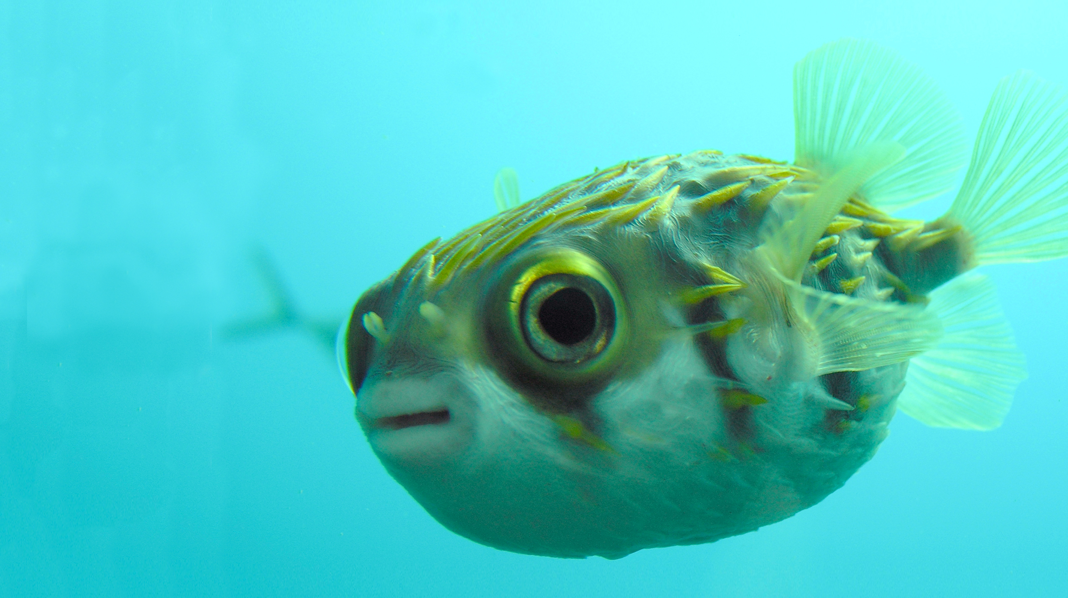
Globefish are poor swimmers and rely on short and sharp spines over the body for protection.
When threatened they can inflate the body by swallowing air or water. They have fused teeth
that can inflict a powerful bite
and its flesh contains a
highly lethal poison.
Globefish
Photo: © Carina Gemignani

Slide 19
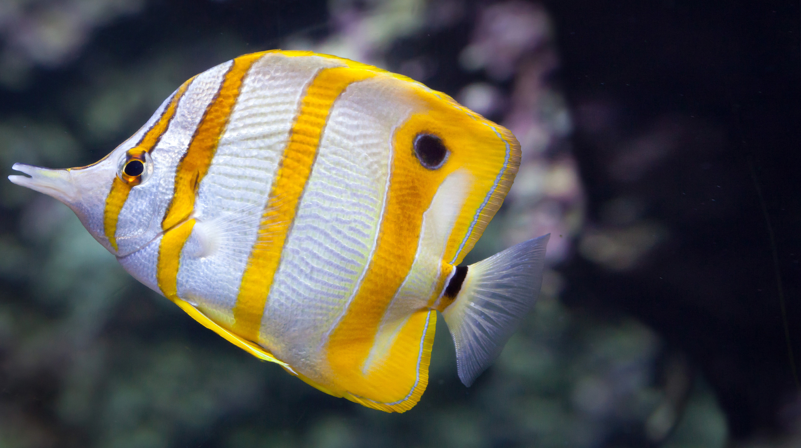
Butterflyfish have a compressed body and fins which allow for increased maneuverability around reef structures. They have a pointed snout used for feeding in narrow crevices.
A false eyespot and band through the eyes helps to confuse predators. The colour yellow is a good matching camouflage to background coral.
Butterflyfish

