Slide 1

Artemia
(sea monkeys)

Slide 2
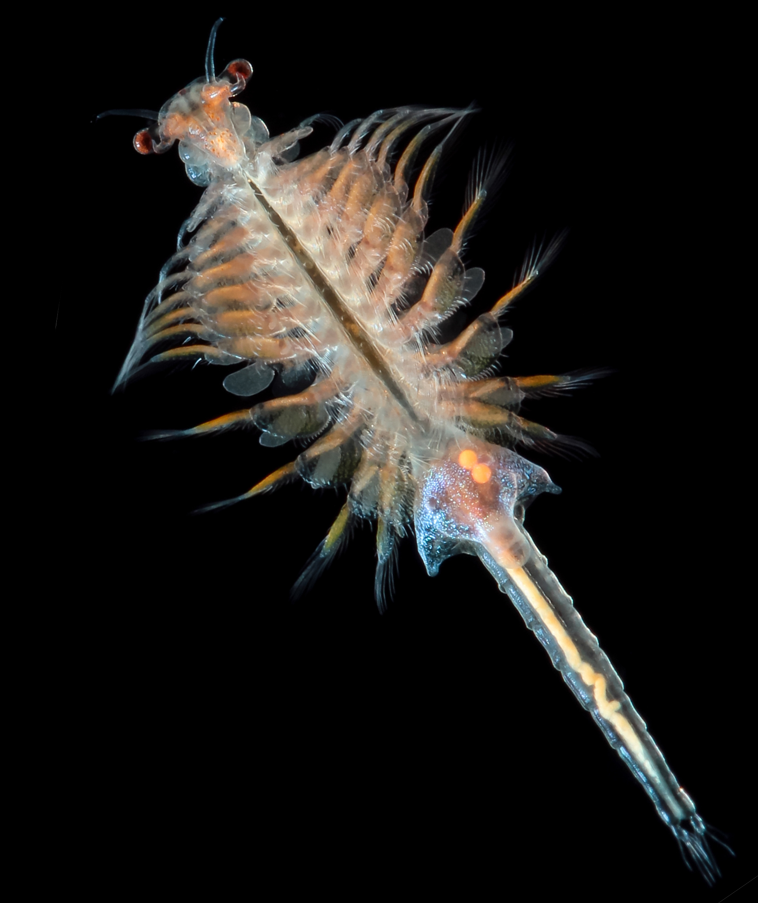
What are Artemia?
Artemia are also known as
Brine Shrimp or Sea Monkeys!
They are a crustacean – they
are related to crabs, lobsters, prawns etc.
They have 11 pairs of legs.

Slide 3
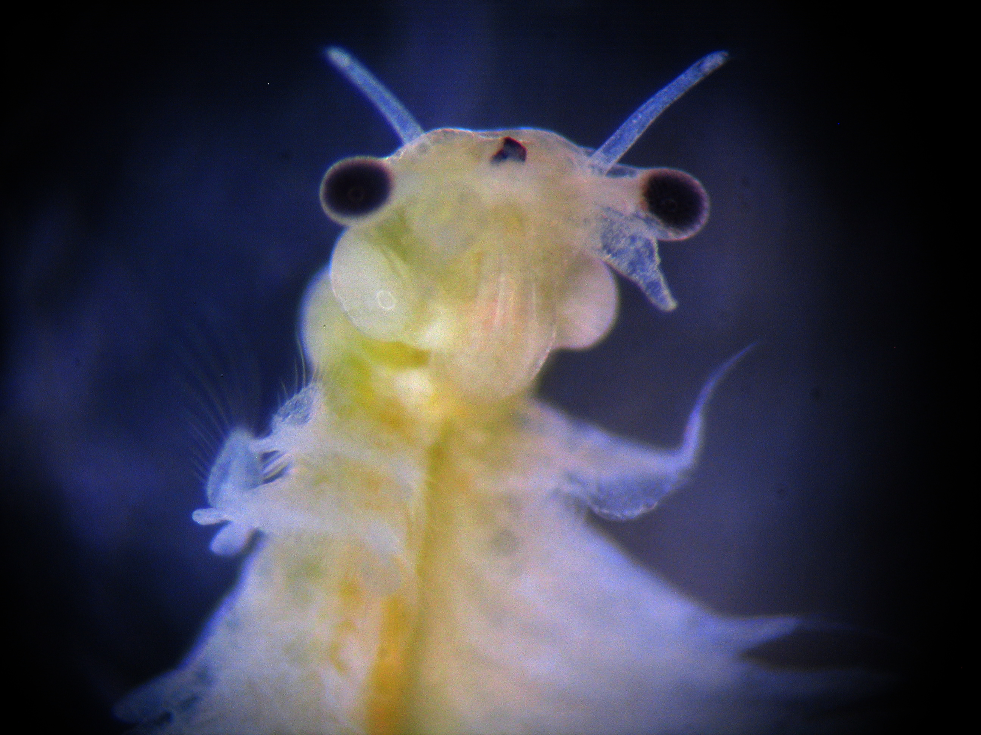
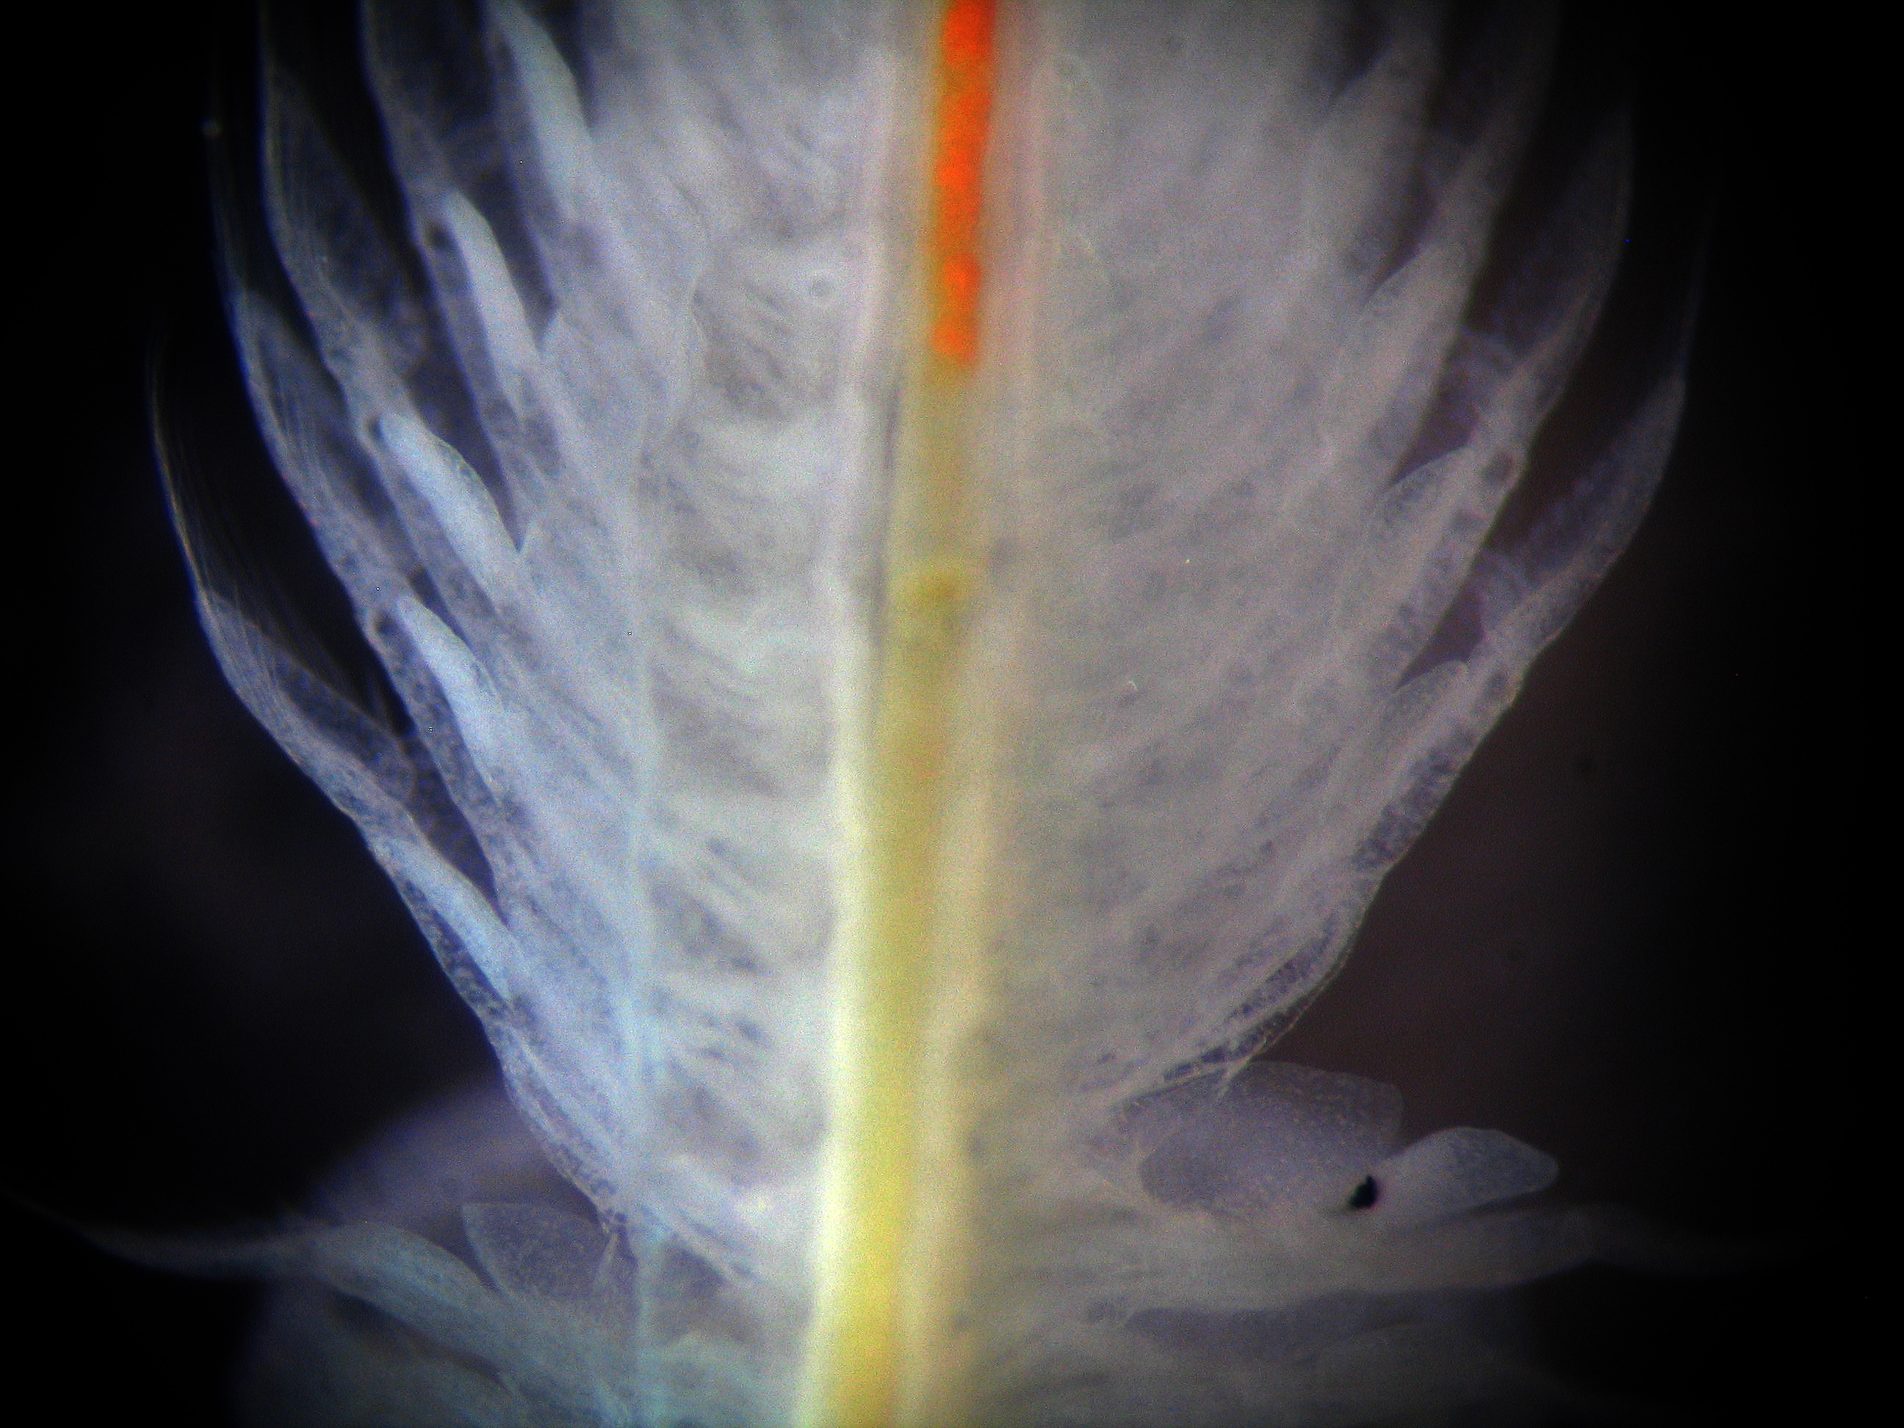
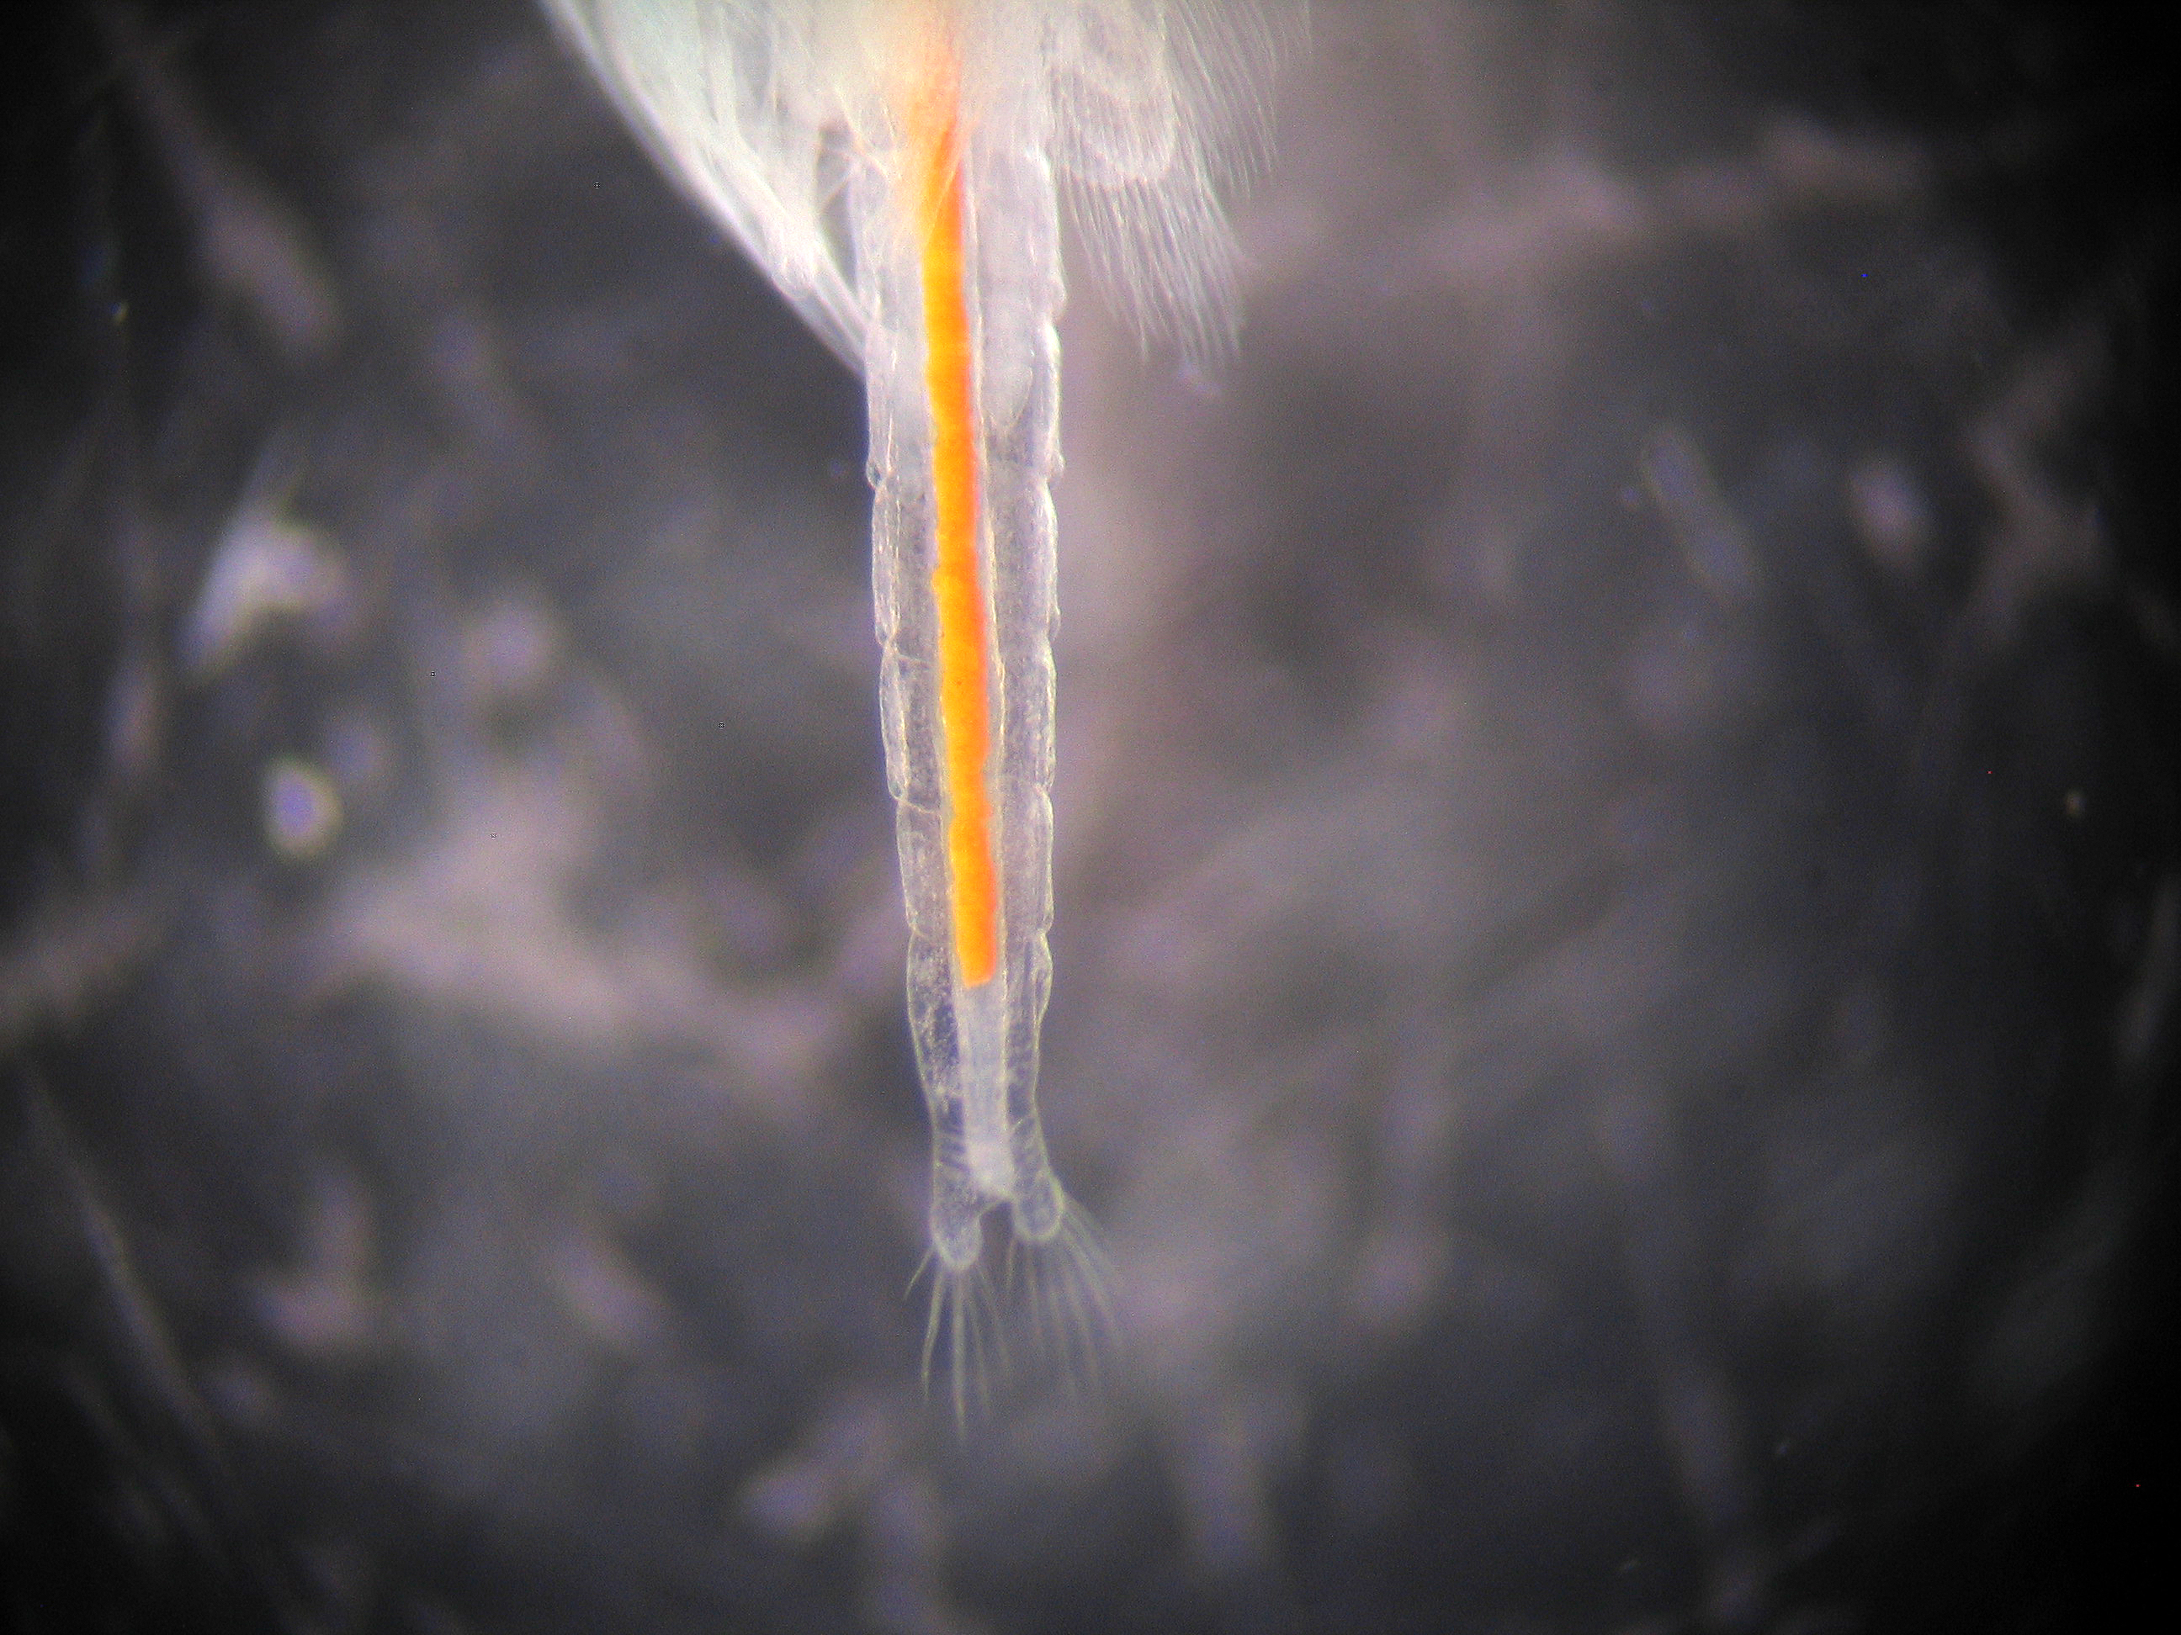
What are Artemia?
The body plan of crustaceans is divided into 3 parts:
Head
Thorax (middle)
Abdomen (tail)

Slide 4
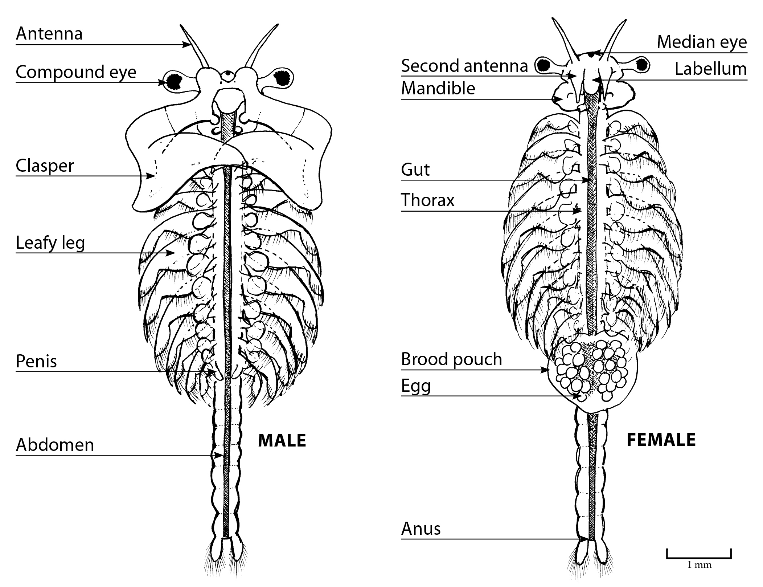
Is it a boy or a girl?
Female Artemia are on average a millimetre longer than the males.
Males have large clasping structures.
Females have a brood pouch containing eggs.

Slide 5
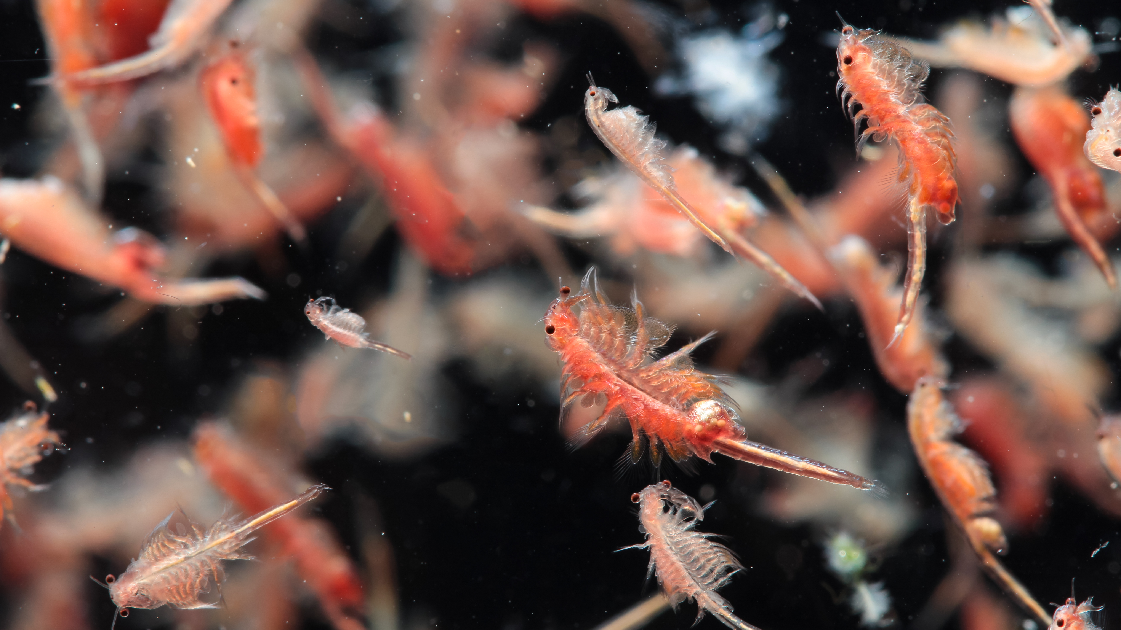

Slide 6
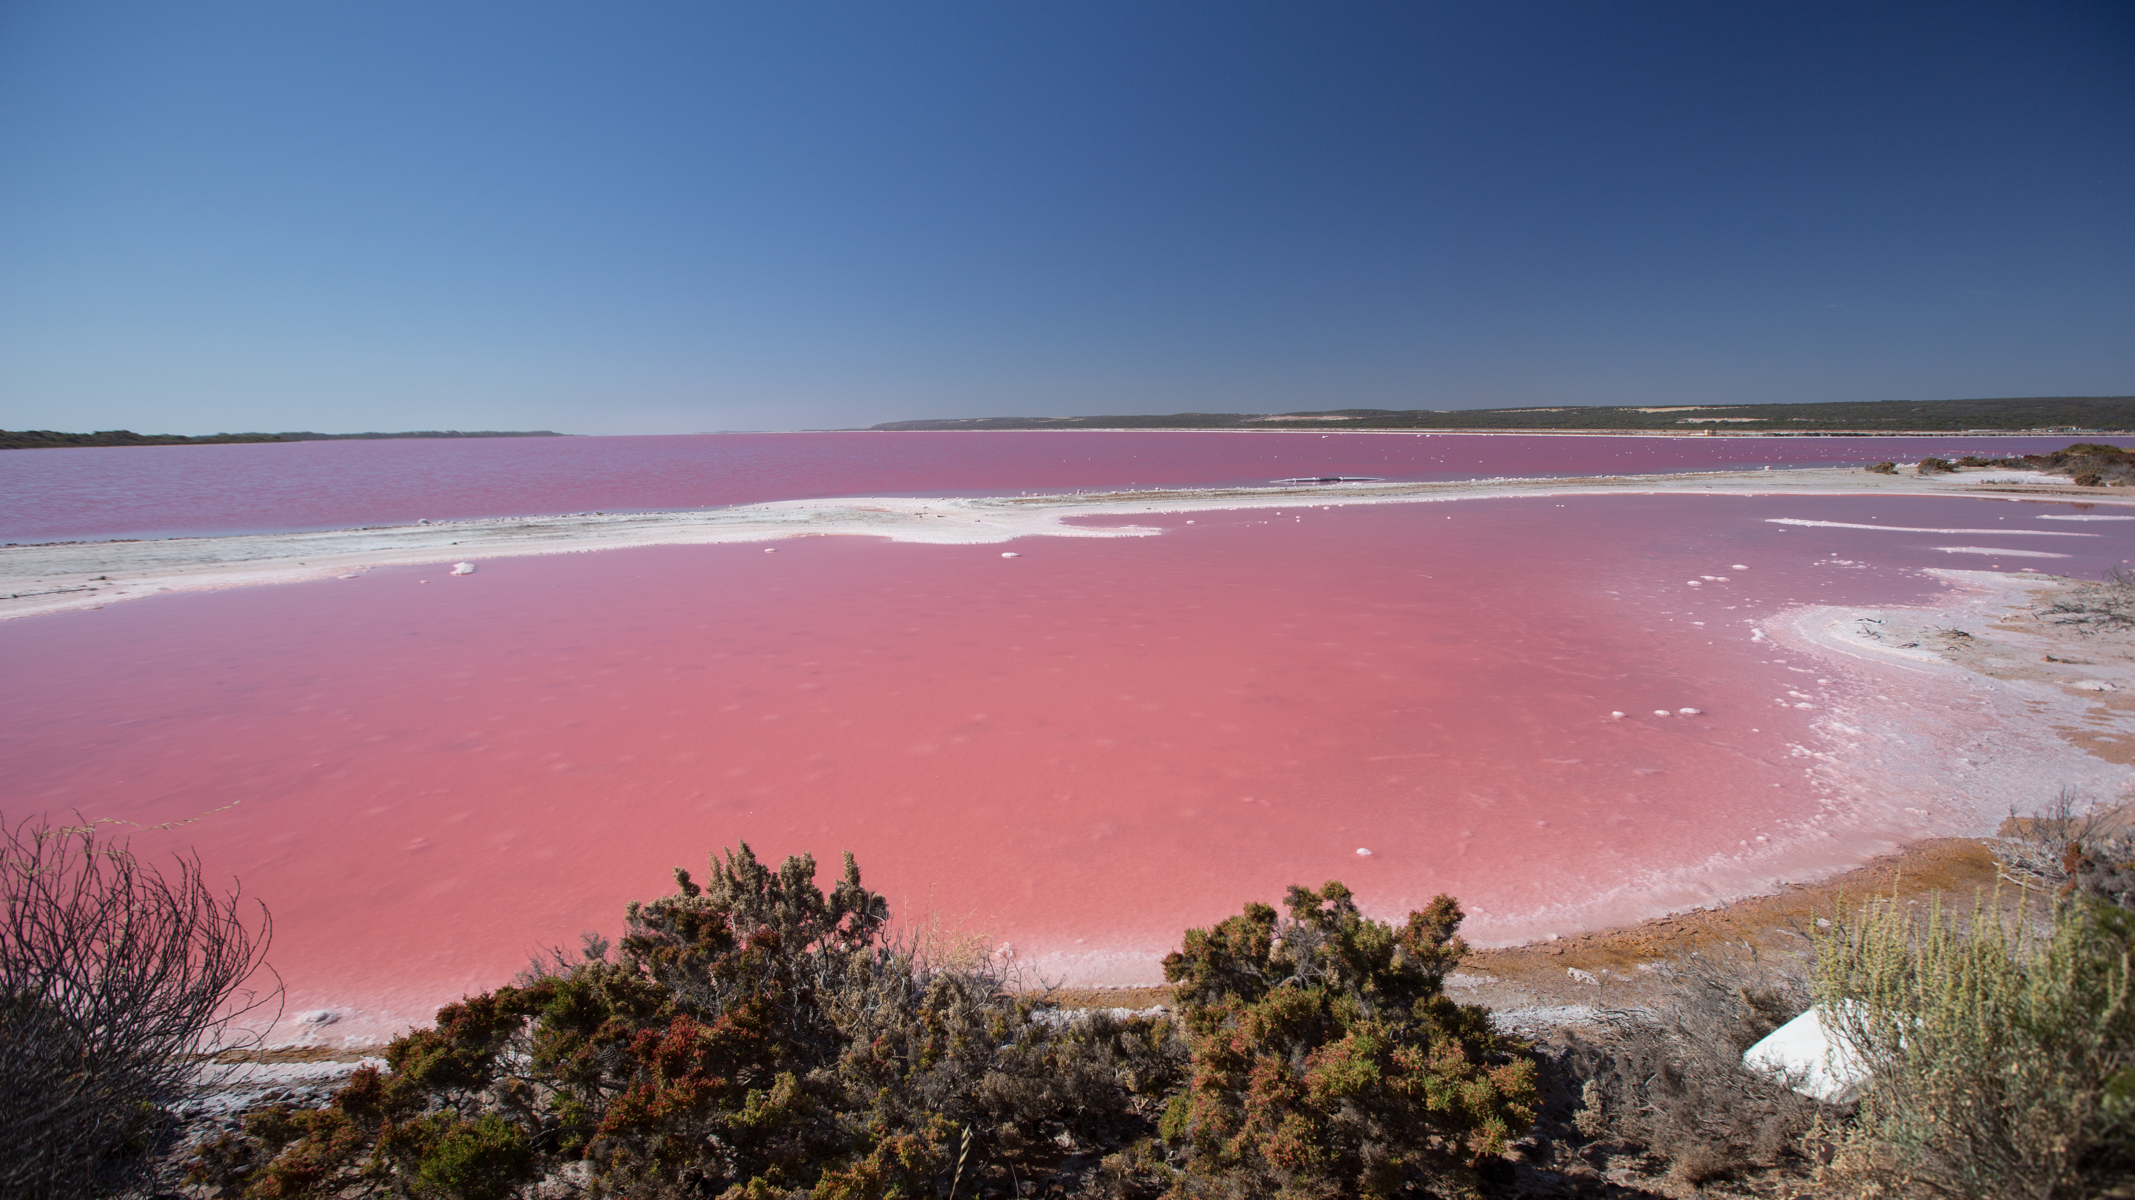
Where do Artemia live?
Artemia live in salt lakes and dried up salt flats around the world – including the salt lakes on Rottnest Island.

Slide 7
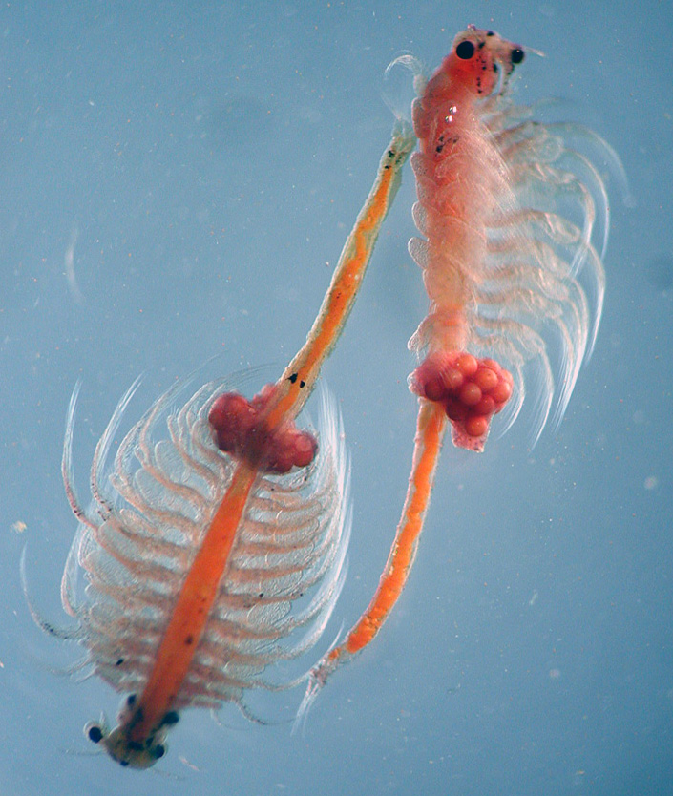
Where do Artemia live?
Artemia produce cysts which is an egg with a hard shell. These cysts only hatch when water is in the salt lake.
Cysts can survive temperatures that are below freezing and in areas where there is no oxygen!

